Slide 1
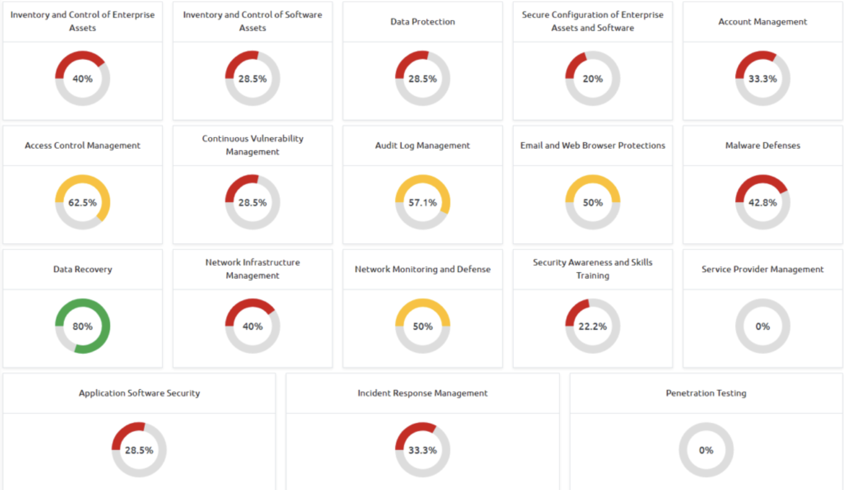
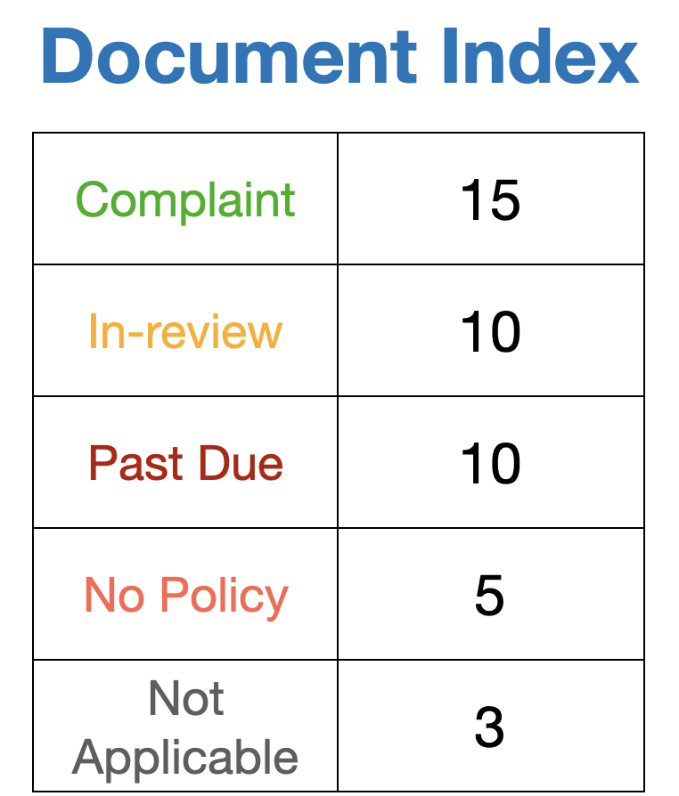
Policy Matrix
Policies, Standards and Procedures - Heat Map

